Slide 1
5 Axes Mills
One of the most advanced manufacturing tools
Cole Beasley

Slide 2
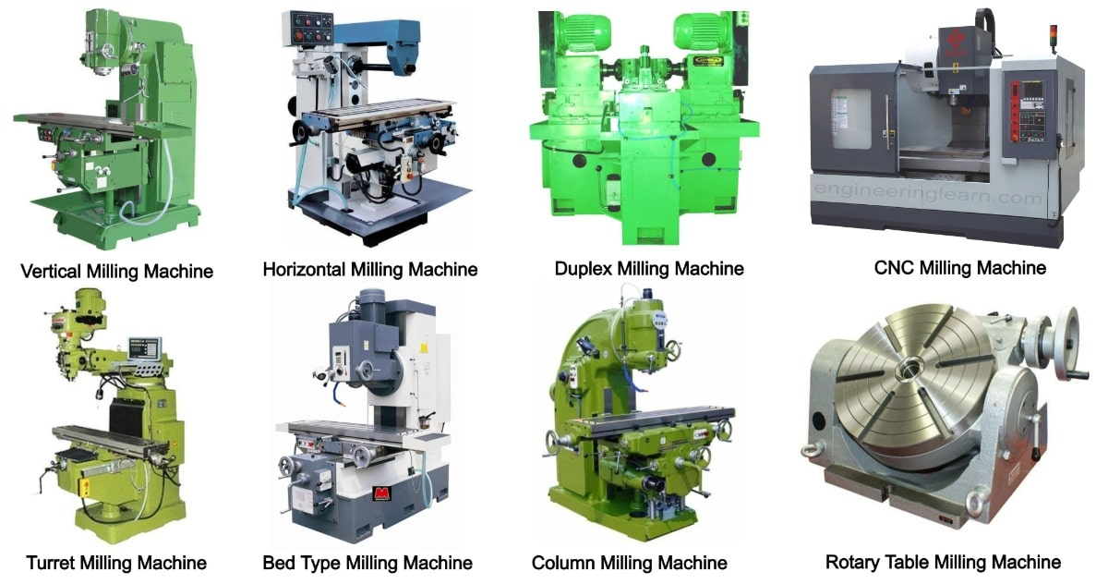
What is a Mill
01
02
Subtractive Manufacturing
1 or More Axes
Takes material away to create a part
Cutter or part can be moved several directions
03
04
Wide Range of Types
Main Manufacturing Method
Personal manual mills for wood to fully automatic metal mills
One of the most common for metal along with casting and forging.

Slide 3
Mill History
~1810s
Numerical Control Machines
1950s
Industry Wide
Cutting machines driven by numerical coordinates
Mills used across most industries from turbine blades to prosthetics
First Mill
First CNC Machine
Mills began being produced in the US
Cincinnati Milacron Hydrotel developed
1940s
2023

Slide 4
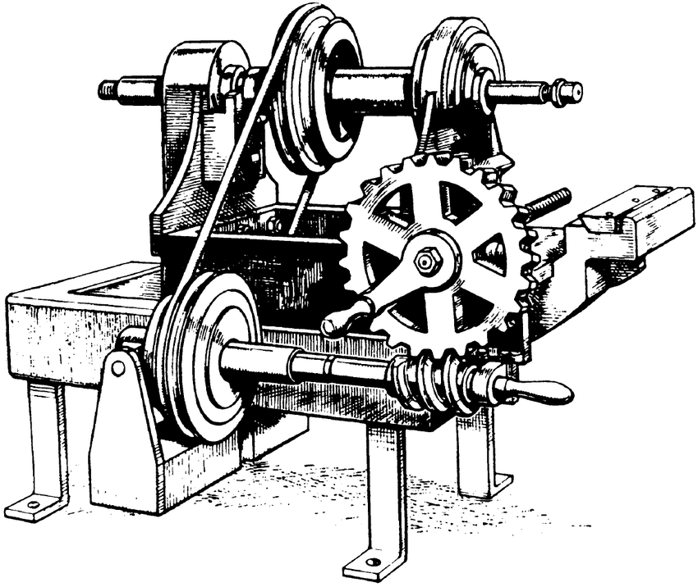
Mill History
Eli Whitney Mill

Slide 5
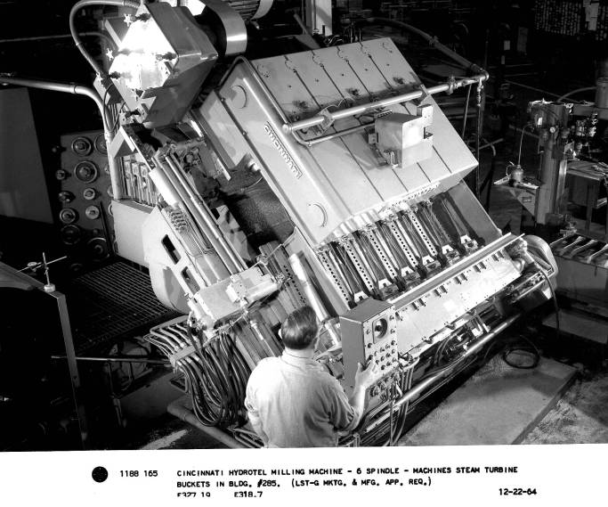
Mill History
Cincinnati Milacron Hydrotel

Slide 6
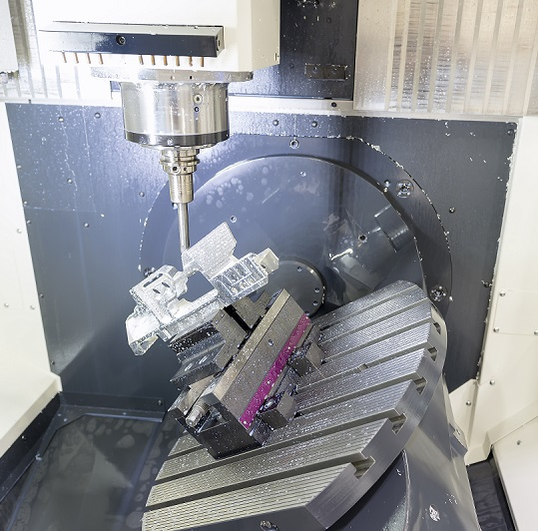
5 Axis Mill
Most Advanced
Can manufacturer most advanced parts.
Part Rotation
2 additional axis to remove problem of overhang
High Precision
Thousandth of a millimeter precision on top machines, more smooth

Slide 7
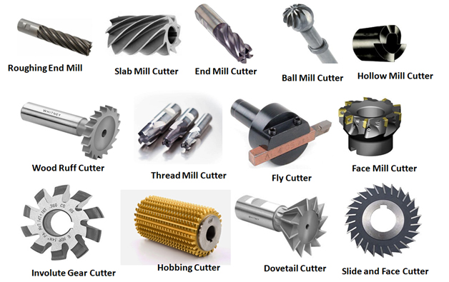
Tool Types
Speed
Versatility
Optimize machining process with the right tool
Even more cutting possibilities when tools can be changed

Slide 8
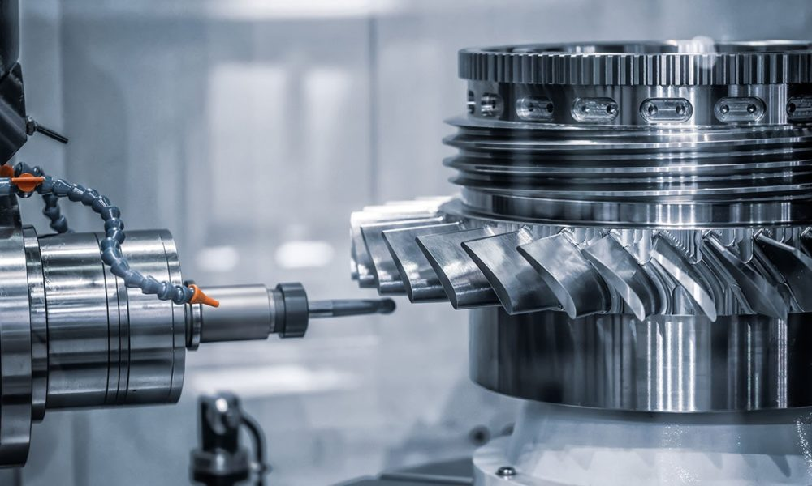
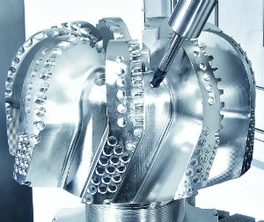
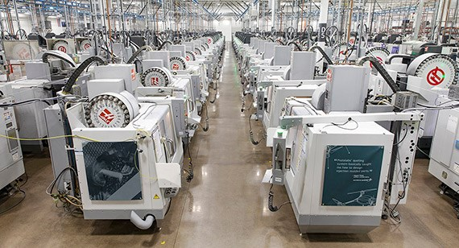
Industry Use
Highly custom examples of mills
Nearly 100 billion USD industry
Used in most manufacturing sectors

